Slide 1
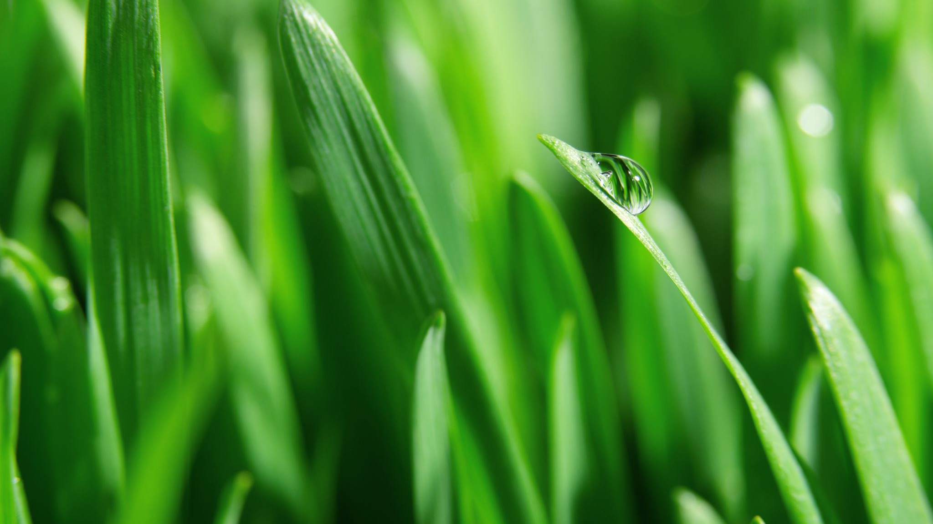
HTTP Methods & Response Codes
- #GREENLEARNER --

